Slide 1
I/O and scannar

Slide 2
I/O operations
Three steps:
Open an input/output stream associated with a physical device (e.g., file, network, console/keyboard), by constructing an appropriate I/O stream instance.
Read from the opened input stream until "end-of-stream" encountered, or write to the opened output stream (and optionally flush the buffered output).
Close the input/output stream.

Slide 3
Basic I/O - Stream
Programs read inputs from data sources (e.g., keyboard, file, network, memory buffer, or another program) and write outputs to data sinks (e.g., display console, file, network, memory buffer, or another program). In Java standard I/O, inputs and outputs are handled by the so-called streams.
A stream can be defined as a sequence of data.
Packages
  Java.io (stream based IO)
  Java.nio(Buffer and channel-Based IO)

Slide 4
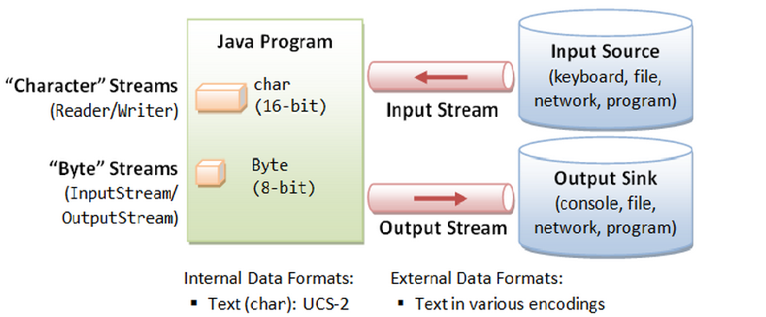
Stream Types
Byte Streams
Character Streams

Slide 5
Byte Streams – Abstract Class
Programs use byte streams to perform input and output of 8-bit bytes.
All byte stream classes are descended from InputStream and OutputStream.
InputStream and OutputStream are abstract classes that cannot be instantiated
Important methods:
  read()
  write()

Slide 6
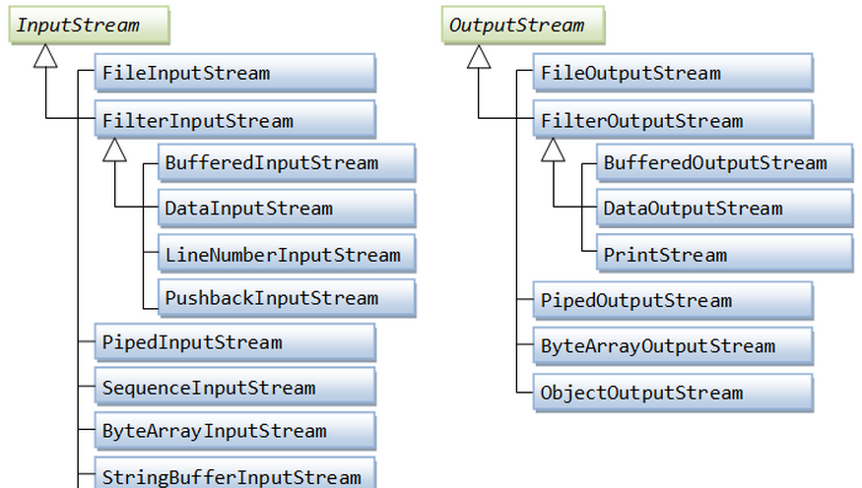
Implementations of abstract InputStream/OutputStream

Slide 7
FileInputStream: Constructors
FileInputStream(String name) Creates a FileInputStream by opening a connection to an actual file, the file named by the path name in the file system.
FileInputStream(File file) Creates a FileInputStream by opening a connection to an actual file, the file named by the File object file in the file system.

Slide 8
InputStream: read methods`
int read() :To read next one byte of data from the input source. The value byte is returned as an int in the range 0 to 255. If no byte is available because the end of the stream has been reached, the value -1 is returned.
int read(byte[] b): Reads some number of bytes from the input stream and stores them into the buffer array b. The number of bytes actually read is returned as an integer
int read(byte[] b, int off, int len): Reads up to len bytes of data from the input stream into an array of bytes. An attempt is made to read as many as len bytes, but a smaller number may be read. The number of bytes actually read is returned as an integer.
All these methods throws IOException

Slide 9
FileInputStream: Constructors
FileOutputStream(File file) Creates a file output stream to write to the file represented by the specified File object.
FileOutputStream(File file, boolean append) Creates a file output stream to write to the file represented by the specified File object.
FileOutputStream(String name) Creates a file output stream to write to the file with the specified name.
FileOutputStream(String name, boolean append) Creates a file output stream to write to the file with the specified name.
If the second argument is true, then bytes will be written to the end of the file rather than the beginning.

Slide 10
OutputStream: write methods
void write(int unsignedByte)
  Writes the specified byte to this output stream.
void write(byte[] bytes, int offset, int length)
  Write "length" number of bytes, from the bytes array starting from offset of index.
void write(byte[] bytes)
  Write length number of bytes, from the bytes array starting from offset of index

Slide 11
Opening & Closing I/O Streams
public void close() throws IOException // close this Stream
  FileInputStream in = null;
  try { in = new FileInputStream(...); // Open stream ...... ...... }
  catch (IOException ex) { ex.printStackTrace(); }
  finally { // always close the I/O streams
  try { if (in != null) in.close(); } catch (IOException ex) { ex.printStackTrace(); } }

Slide 12
Flushing the OutputStream
public void flush() throws IOException // Flush the output

Slide 13
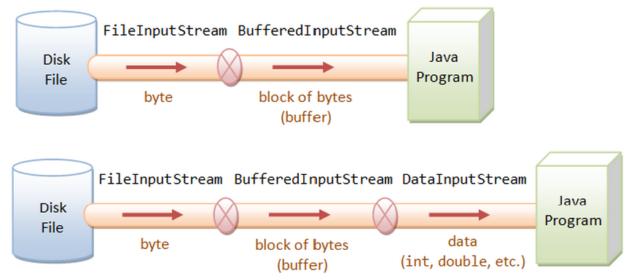
Layered (or Chained) I/O Streams

Slide 14
Character Streams – Abstract Class
Reader is used to read data from a source
Writer is used for writing data to a destination
Important methods:
  read()
  write()

Slide 15
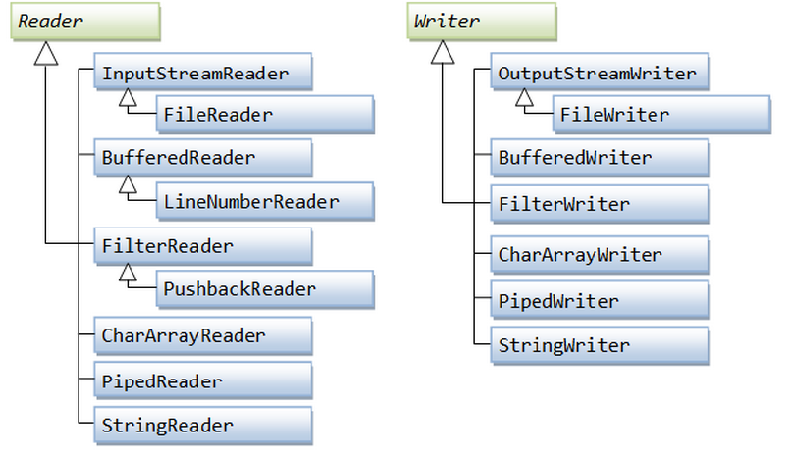
Character-Based I/O & Character Streams

Slide 16
Reader : Read method
There are also variations of read() to read a block of characters into char-array.
public abstract int read() throws IOException
public int read(char[] chars, int offset, int length) throws IOException
public int read(char[] chars) throws IOException

Slide 17
Writer: Write Method
public void abstract void write(int aChar) throws IOException
public void write(char[] chars, int offset, int length) throws IOException
public void write(char[] chars) throws IOException

Slide 18
File I/O Character-Streams - FileReader & FileWriter
FileReader and FileWriter are concrete implementations to the abstract super classes Reader and Writer, to support I/O from disk files.
FileReader/FileWriter assumes that the default character encoding (charset) is used for the disk file. The default char set is kept in the JVM's system property

Slide 19
Buffered I/O Streams -
BufferedInputStream & BufferedOutputStream
–These stream can be stacked on top of (FileInputStream/FileOutputStream) to perform buffered I/O, instead of byte-by-byte
BufferedReader and BufferedWriter
  These streams can be stacked on top of FileReader/FileWriter or other character streams to perform buffered I/O, instead of character-by-character.
  BufferedReader provides a new method readLine(), which reads a line and returns a String (without the line delimiter). Lines could be delimited by "\n" (Unix), "\r\n" (Windows), or "\r" (Mac).

Slide 20
Data I/O Streams
Data streams support binary I/O of primitive data type values (boolean, char, byte, short, int, long, float, and double) as well as String values
DataInputStream
  A data input stream lets an application read primitive Java data types from an underlying input stream in a machine-independent way
  readBoolean(), readByte(), readInt(), readFloat()
DataOutputStream
  A data output stream lets an application write primitive Java data types to an output stream in a portable way. An application can then use a data input stream to read the data back in
  writeBoolean(), writeByte(), writeInt(), writeFloat()

Slide 21
Object Streams -
Object streams support I/O of objects. Most, but not all, standard classes support serialization of their objects. Those that do implement the marker interface Serializable
ObjectInputStream
  An ObjectInputStream deserializes primitive data and objects previously written using an ObjectOutputStream.
  readObject()
ObjectOutputStream
  An ObjectOutputStream writes primitive data types and graphs of Java objects to an OutputStream.
  Persistent storage of objects can be accomplished by using a file for the stream
  writeObject()

Slide 22
Files Class

Slide 23
File: Overview
The File class in the Java IO API gives you access to the underlying file system
This class gives you access to the file and file system meta data
(JDK7)
The java.nio.file package and its related package, java.nio.file.attribute, provide comprehensive support for file I/O and for accessing the default file system.

Slide 24
File : Constructors
public File(String pathName)
  Creates a new File instance by converting the given pathname string into an abstract pathname.
public File(String parent, String child)
  Creates a new File instance from a parent pathname string and a child pathname string.
public File(File parent, String child)
  Creates a new File instance from a parent abstract pathname and a child pathname string.
public File(URI uri)
  Constructs a File instance by converting from the given file-URI "file://....

Slide 25
File Constructor: Exmple
A file relative to the current working directory
  File file = new File("in.txt")
A file with absolute path
  File file = new File("d:\\myproject\\java\\Hello.java");
A directory
  File dir = new File("c:\\temp")

Slide 26
File/Directory: Checking Properties
Tests if this file/directory exists.
  public boolean exists()
Returns the length of this file.
  public long length()
Tests if this instance is a directory.
  public boolean isDirectory()
Tests if this instance is a normal file.
  public boolean isFile()
Tests if this file is readable.
  public boolean canRead()

Slide 27
File/Directory: Checking Properties
Tests if this file is writable.
  public boolean canWrite()
Deletes this file/directory.
  public boolean delete()
Deletes this file/directory when the program terminates.
  public void deleteOnExit()
Renames this file.
  public boolean renameTo(File dest)
Makes (Creates) this directory.
  public boolean mkdir()

Slide 28
Directory: Listing
List of files as arrays of strings
  public String[] list()
List of files as Files
  public File[] listFiles()
Renames this file
  public boolean renameTo(File dest)
Makes (Creates) this directory.
  public boolean mkdir()

Slide 29
Serialization
Serialization is the process of writing the state of an object to a byte stream
Only an object that implements the Serializable interface can be saved and restored by the serialization facilities
The Serializable interface defines no members. It is simply used to indicate that a class may be serialized
If a class is serializable, all of its subclasses are also serializable.

Slide 30
Serialization: transient
The transient keyword is used in serialization.
Any data member declared as transient, will not be serialized
    import java.io.Serializable;
    public class Student implements Serializable{
    int id;
    String name;
    transient int age;//Now it will not be serialized
    }

Slide 31
Cloning
The clone( ) method generates a duplicate copy of the object on which it is called
Only classes that implement the Cloneable interface can be cloned
The Cloneable interface defines no members. It is used to indicate that a class allows a bitwise copy of an object (that is, a clone) to be made
When a clone is made, the constructor for the object being cloned is not called. A cloneis simply an exact copy of the original.

Slide 32
SCANNER Class

Slide 33
Interactive programs
We have written programs that print console output, but it is also possible to read input from the console
The user types input into the console. We capture the input
and use it in our program
Such a program is called an interactive program

Slide 34
Input and System.in
System.out
An object with methods named println and print
System.in
not intended to be used directly
We use a second object, from a class Scanner, to help us.

Slide 35
_x0001_ Constructing a Scanner object
Scanner is in a package named java.util
import java.util.*;
Scanner name = new Scanner(System.in);
Example:
Scanner console = new Scanner(System.in);

Slide 36
Scanner methods
Method
nextInt()
nextDouble()
next()
nextLine()
Each method waits until the user presses Enter.

